Slide 1
Reading Skills
https://www.oxfordonlineenglish.com/english-level-test/reading

Slide 2
Reading Skill
Average college student- read 150-200 words/min. Fast readers-250-400 words/ min.
Reading is one of the most important activities any successful student does in any course of study. It is important to note that reading is an active process; you need to apply strategies that will enable you make sense of what you read.

Slide 3
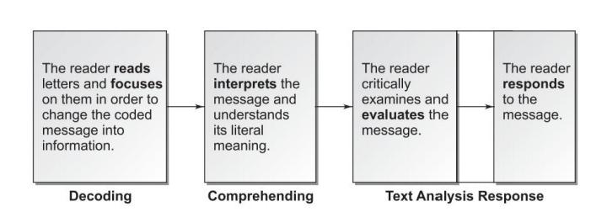
The reading process

Slide 4
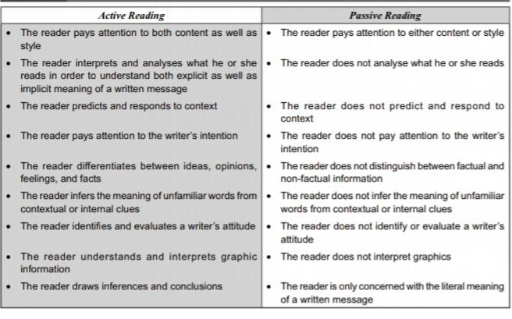
Types of reading

Slide 5
Techniques for good comprehension skills
A good way of getting started on developing your reading skills is to think about how you read a text or passage. There are several techniques that you can use.

Slide 6
Scanning
The technique of scanning is a useful one to use if you want to get an overview of the text you are reading as a whole – its shape, the focus of each section, the topics or key issues that are dealt with, and so on. In order to scan a piece of text you might look for subheadings or identify key words and phrases which give you clues about its focus. Another useful method is to read the first sentence or two of each paragraph in order to get the general gist of the discussion and the way that it progresses.
Examples of Scanning
The "What's on TV" section of your newspaper.
A telephone number in the directory
A horoscope guide

Slide 7
Skimming
Skimming is used to quickly gather the most important information, or 'gist'. Run your eyes over the text, noting important information. Use skimming to quickly get up to speed on a current business situation. It's not essential to understand each word when skimming. Skimming is covering the chapter to get some of the main ideas and a general overview of the material. It is what you do first when reading a chapter assignment. You don’t read for details at this point.
The Newspaper (quickly to get the general news of the day)
Magazines (quickly to discover which articles you would like to read in more detail)
Business and Travel Brochures (quickly to get informed

Slide 8
Non-verbal signals
The meaning of the text is not only conveyed by means of words. All text also contains non-verbal signs. Non verbal signs may include certain style features such as bold font, CAPITAL FONTS, italics, etc. these words are used to highlight, emphasize, point out something.

Slide 9
Structure of the text
Most text starts with a title or subtitle. After that comes the introduction and the body, followed by a conclusion or summary. An important aspect of reading is prediction. The better you can predict what you are going to read, the faster and more effective you will read. It also includes structure of paragraphs which includes opening segment of a paragraph, middle and ending part of the paragraph. In many well written texts a reader can easily get full idea about the paragraphs by just reading opening or topic sentence of the paragraph.

Slide 10
Punctuation
Punctuation is partly based on grammar. For example, commas are often used to separate clauses. Punctuation marks also indicate how the author wants you to interpret a piece of text.

Slide 11
Seen and Unseen Passages
A seen passage refers to the one you might have discussed or seen before while an unseen passage is often a passage which is used to test the knowledge that you have grasped by understanding it. Though they both include questions which you give answers too.

Slide 12
Literary Vs Technical Writing
Literary writing is a style of writing that is used in creative and literary work.
This is the style of writing that is used in fiction.
Examples for literary writing includes poems, novels, short stories, dramas etc.
The most significant difference between literary writing and other styles of writing is that the language used in literary writing uses many literary figures.
Technical writing is a style of writing used in delivering technical information regarding a particular subject.
Technical writing is the style of writing that is mostly observed in Non-fiction.
Examples for technical writing include essays, manuals, reports etc. This style of writing is direct and simple.
Here, the intended audience should have a certain knowledge about the subject in order to understand the technical jargon and the meaning of the text.

Slide 13
Reading with Speed and Accuracy

Slide 14
Developing a good reading speed
As we have to read both extensively as well as intensively, we cannot afford to read slowly.
Extensive reading is a must to broaden our general understanding of a subject while intensive reading is required to get an in-depth knowledge and understanding of the finer details of a subject.
Most productive examinations demand selective intensive reading of some topics. On the other hand, recognition type examinations such as objective tests (true/false, multiple choice) demand wide extensive reading of a large number of topics.
The reading needs may vary but in order to improve reading efficiency reading speed has to be increased.

Slide 15
Developing a good reading speed
Reading speed is measured in words per minute (wpm).
Casual or general reading such as reading novels, poems, stories, and humorous articles do not require much concentration and, therefore, the reading speed is faster than that of serious reading.
However, academic or professional reading such as reading technical texts, articles, and proposals require more concentration and reading speed cannot be increased at the cost of reading efficiency.

Slide 16
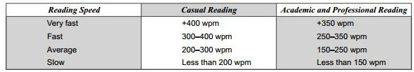
Reading Speed Indicators for Different Purposes
http://www.readingsoft.com/

Slide 17
Scanning and Skimming
Before starting to read a text in detail, you should take a moment to preview the text. Read quickly, without pausing to study the details. This is called skim reading or skimming. You should understand
• for which audience the text was written (general public, professionals, laymen)
• what type of text it is (report, informal letter, formal letter, article, advertisement)
• what the purpose of the author is (to describe, to inform, to explain, to instruct, to persuade); and
• the general contents of the text.
After having skimmed the text, you can study it in more detail, reading more slowly and carefully and looking for specific information that you are interested in. This is called scanning.

Slide 18
Scanning
Scanning is reading something rapidly for some specific piece of information.
You can use this skill when you are in search of keywords, for example, scanning a telephone book or a dictionary to look for a name or a word. You ‘see’ every item on the page but you do not necessarily read all the pages—you skip anything you are not looking for. You just have to concentrate on the key word and need not recall the exact content of the page. Scanning saves time but it has to be done with accuracy. This skill develops with practice.

Slide 19
Purposes of scanning
(a) A specific point or fact in a text
(b) Relevant graphic details
(c) A formulae in a text
(d) A word in a dictionary
(e) Train or television schedules
(f) Any references or bibliographical listings
(g) Examination results
(h) Any notes/questions/remarks at the end of the text

Slide 20
Suggestions to increase proficiency at scanning.
Use Guides and Aids: Every reading material contains certain guides and aids, which should be used to find what the reader wants.
Know the Organisation of the Material to be Read: The reader needs to know the organisation of the reading material to scan it with speed and accuracy. Practise scanning different kinds of reading materials, such as newspaper listings, dictionaries, telephone directories, and analyse the way information is structured in these materials.

Slide 21
Suggestions to increase proficiency at scanning.
Know What You Want to Find : In order to scan any reading material, the reader needs to know what he/she wants to find. If he/she does not know what he/she is looking for, he/she will not be able to scan well. So, the purpose of scanning should be determined and the reader should not be confused about the information that he/she requires.
Do Not Read Everything: As the reader knows what he/she is looking for before he/she begins to read, he/she should not read everything. He/she should concentrate on the information that he/she needs with his/her eyes only on the particular word, phrase, and word group or thought unit that he/she is looking for. The attempt should be to perceive word groups and thought units quickly.

Slide 22
Suggestions to increase proficiency at scanning.
Concentrate While Scanning: The reader needs to concentrate while scanning a reading material. He/she must have the urge to read and scan the material. This will improve his visual perception and help him identify the required information quickly.

Slide 23
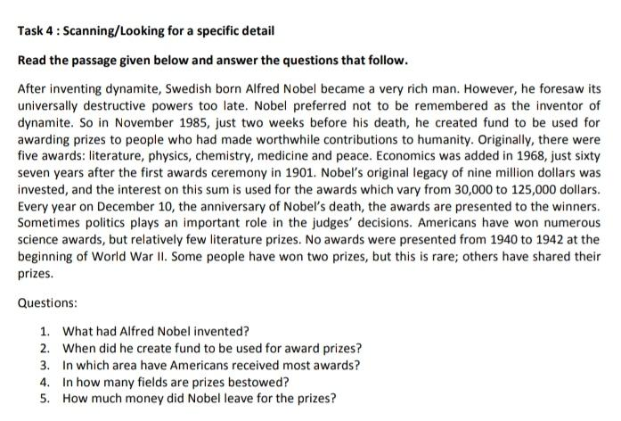

Slide 24
Skimming
Skimming is reading a text quickly to gain a general impression whether the text is of any use to you or not.
You can see people skimming through books in a bookstore before they decide to buy them. You need not necessarily search for a specific item or a key word and many parts of the material may be left unread.
The purpose of skimming is to get an ‘overview’ of the text that is to check its relevance, grasp its central theme and the main points. It prepares you for the more concentrated effort of detailed reading, which is to follow, if the text is useful.

Slide 25
Skimming should answer the following questions about a text.
1. What is the overall purpose of the text?
2. What is the central idea or theme?
3. What is the logical organisation? (general to specific, specific to general, chronological, more important to less important, less important to more important, and so on.)
4. What does the author intend to do? (describe, instruct, report, narrate, explain, argue, persuade, illustrate, and so on.)
5. What are the main points of the text?

Slide 26
Here is how you skim a chapter:
Read the first paragraph of the chapter line by line.
Next, read all the bold print headings starting at the beginning.
Read the first sentence of every paragraph.
Study any pictures, graphs, charts, and maps.
Finally, read the last paragraph of the chapter.
As you skim, you could write down the main ideas and develop a chapter outline.

Slide 27
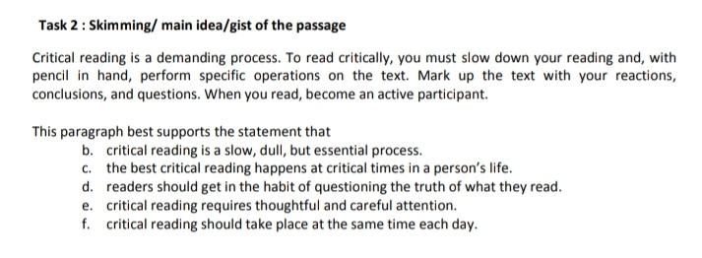

Slide 28
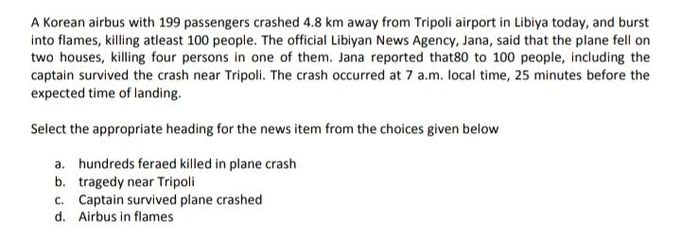

Slide 29
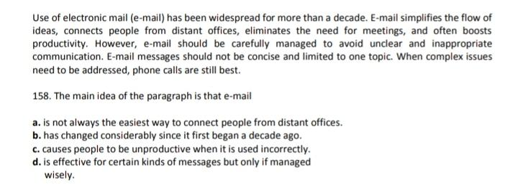
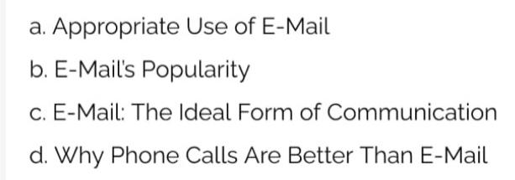

Slide 30
Distinguishing between Facts and Opinions
A reader should be able to distinguish facts from opinions and ideas.
Distinguishing between facts and opinions requires the ability to read with critical response and analyse the information in a text.
It requires contributions by, both, the author and the reader and involves critical and analytical skills. So, it involves the reader’s understanding of a text as well as his/her response to it.

Slide 31
Distinguishing between Facts and Opinions
A fact is a truth that can be objectively verified by observation or experimentation.
On the contrary, an opinion is something subjective, which cannot be objectively verified.
Although science is mainly concerned with facts, opinions are also important.
A discerning reader must make a distinction between the two to avoid confusion and misunderstanding.

Slide 32
Find out the facts and opinions from the given statements.
Nearly two-thirds of India’s population depends directly on agriculture for its livelihood.
The coming of multinational companies to India has boosted the Indian economy.
Several multinational companies have opened their offices in India.
India is an agricultural country.
The Government of India has reduced IIM fees.
India is a great country
Indian farmers are the best in the world.
Reduction of IIM fees by the government is a retrograde step.

Slide 33
Differences Between Facts and Opinions
Fact
Opinion
India is an agricultural country.
Nearly two-thirds of India’s population depends directly on agriculture for its livelihood.
Several multinational companies have opened their offices in India.
The Government of India has reduced IIM fees.
India is a great country
Indian farmers are the best in the world.
The coming of multinational companies to India has boosted the Indian economy
Reduction of IIM fees by the government is a retrograde step.

Slide 34
Understanding Topic and Argument
The topic of a passage is what the passage is about.
The argument of a passage is the author's point of view about the topic.
The argument is sometimes also called the main claim or the thesis. The argument will be something debatable - if you can't argue the other side of the issue, it isn't an argument.

Slide 35
Understanding Topic and Argument
Passages on the same topic can make different arguments. For example, imagine three passages all on the topic of global warming:
Passage one argues that it does exist and is caused by human activities.
Passage two argues that it does exist, but is not caused by human activities.
Passage three argues that it doesn't exist at all.
Same topic; different arguments.

Slide 36
THE SQ3R METHOD
The SQ3R method was put together by Francis Robinson in 1970 as an active and effective method of reading. It is one of the methods best known for reading faster and retaining more. SQ3R stands for the steps in reading: survey, question, read, recite, review. The following are the steps in detail.
Survey
Before reading, survey the material. Look through the main and the sub-headings and try to get an overview. Skim the sections and read the final summary paragraph to get an idea of what the chapter is about. Pay attention to introductory and summary paragraphs and references.

Slide 37
THE SQ3R METHOD
Question
Ask yourself what this chapter is about: What is the question the reading material is trying to
answer? Repeat this process with each subsequent section, turning each heading into a ques-
tion. Asking questions focuses your concentration on what you need to learn or get out of
your reading. This step requires conscious effort that it leads to active reading, the best way
to retain written material.
Read
Read one section at a time, looking for the answer to the question proposed by the heading.
This is active reading and requires concentration. If you finish the section and have not an-
swered the question, reread it. Think while reading. Consider what the author is trying to say,
and think about how you can use that information.

Slide 38
THE SQ3R METHOD
Recite
Once you have read an initial section, write down (sometimes in the margins of the book itself) a key phrase that sums up the major point of the section and answers the question. Here, it is important to use your own words, and make your own connections. Research shows that we remember our own (active) connections better than the ones already provided. At this stage, writing down the answers to your questions helps in retaining and consolidating your understanding.
Review
After reading the entire material, again ask yourself the questions that you have identified right at the beginning. Review your notes for an overview of the chapter. Consider how it fits with what you already know. Think of the significance it has in your general learning scheme.

Slide 39
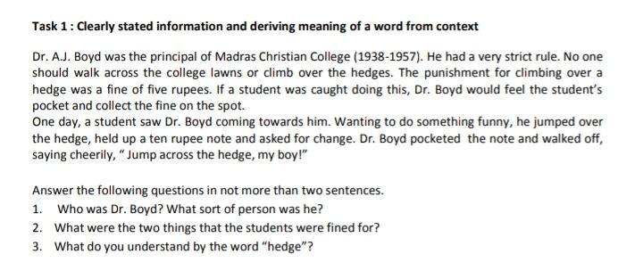

Slide 40
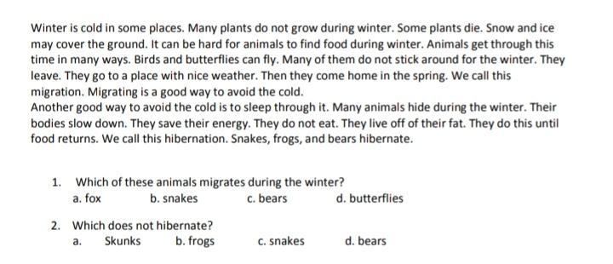

Slide 41
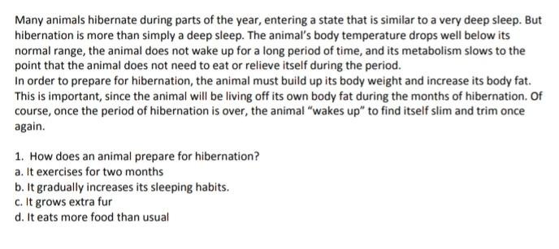
Q. This passage best supports the statement that
a)all animals hibernate to some degree.
b)food is scarce in the winter.
c)hibernation is very different from normal sleep.
d)bears hibernate every year.

Slide 42
Vocabulary
The designer window treatments in her house, installed 17 years ago, were outmoded.
a. unnecessary
b. pointless
c. out-of-date
d. worthless
Although the professor’s lectures were regarded by many as so wearisome that they regularly put students to sleep, he ignored all criticism and refused to make any changes.
a. modest
b. unpleasant
c. boring
d. objectionable

Slide 43
1. When Katya refused to lie to her parents about where she was spending the night, she was completely ostracized by her usually loyal friends, who had never shunned her before.
a. excluded
b. hurt
c. cheered
d. helped
3.You cannot become a certified teacher without completing the prerequisite student teaching assignment.
a. required
b. optional
c. preferred
d. advisable
2.Mr. Powers was so gullible that he believed even the most outlandish excuses of his insincere employees.
a. intelligent
b. naïve
c. dishonest
d. critical
4.The doctors were pleased that their theory had been fortified by the new research.
a. reinforced
b. altered
c. disputed
d. developed

Slide 44
5. Most of the women in the orchestra wore conventional black skirts and white shirts during concerts and had their hair neatly pulled back. Robin, with her brightly colored clothing and unusual hairstyles, was considered quite eccentric.
What is the meaning of the underlined word eccentric as it is used in the sentence?
a. unconventional
b. joyful
c. unreliable
d. proud
6. I wrote in my journal every day, hoping in the future to author a book about my trip to Paris.
a. notebook
b. chapbook
c. diary
d. ledger

Slide 45
Analogies
PETAL : FLOWER
a. recliner : chair
b. leaf : tree
c. basket : ball
d. material : fabric
e. avocado : guacamole
SHELF : BOOKCASE
a. arm : leg
b. stage : curtain
c. bench : chair
d. key : piano
e. lamp : bulb

Slide 46
PHARMACY : DRUGS
a. mall : store
b. doctor : medicine
c. bakery : bread
d. supermarket : discount store
e. toys : games
TEACHER : SCHOOL
a. actor : role
b. mechanic : engine
c. jockey : horse
d. judge : courthouse
e. author : book
SEARCH : FIND
a. sleep : wake
b. explore : discover
c. draw : paint
d. think : relate
e. walk : run
METROPOLITAN : URBAN
a. bucolic : rural
b. sleepy : nocturnal
c. agricultural : cow
d. autumn : harvest
e. agrarian : generous

Slide 47
Main Ideas, Themes
If you’re a fitness walker, there is no need for a commute to a health club. Your neighborhood can be your health club. You don’t need a lot of fancy equipment to get a good workout either. All you need is a well-designed pair of athletic shoes.
Q. This paragraph best supports the statement that
a. fitness walking is a better form of exercise than weight lifting.
b. a membership in a health club is a poor investment.
c. walking outdoors provides a better workout than walking indoors.
d. fitness walking is a convenient and valuable form of exercise.
e. poorly designed athletic shoes can cause major foot injuries.

Slide 48
Mathematics allows us to expand our consciousness. Mathematics tells us about economic trends,patterns of disease, and the growth of populations. Math is good at exposing the truth, but it can also perpetuate misunderstandings and untruths. Figures have the power to mislead people.
This paragraph best supports the statement that
a. the study of mathematics is dangerous.
b. words are more truthful than figures.
c. the study of mathematics is more important than other disciplines.
d. the power of numbers is that they cannot lie.
e. figures are sometimes used to deceive people.

Slide 49
Topic sentence
It weighs less than three pounds and is hardly more interesting to look at than an overly ripe cauliflower. ___________________________. It has created poetry and music, planned and executed horrific wars, and devised intricate scientific theories. It thinks and dreams, plots and schemes, and easily holds more information than all the libraries on Earth.
a. The human brain is made of gelatinous matter and contains no nerve endings.
b. The science of neurology has found a way to map the most important areas of the
human brain.
c. Nevertheless, the human brain is the most mysterious and complex object on Earth.
d. However, scientists say that each person uses only 10% of his or her brain over the course of a lifetime!

Slide 50
Before we learn how to truly love someone else, we must learn how to love the face in the mirror.
a. Don’t be shy about meeting members of the opposite sex.
b. No one can really love you the way you can love yourself.
c. Love is not something that lasts unless one is very lucky.
d. Learning to accept ourselves for who we are will teach us how to accept
another person.

Slide 51
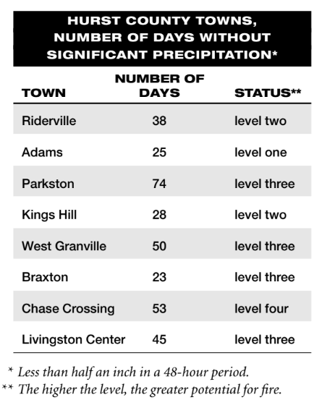
Reading Charts and Graphs
Compared to Kings Hill, Chase Crossing
a. is more likely to experience a fire.
b. is less likely to experience a fire.
c. is just as likely to experience a fire.
d. has gone a shorter period of time without
significant precipitation.

Slide 52
Short Passage
Many cities haves distributed standardized recycling containers to all households with directions that read:“We would prefer that you use this new container as your primary recycling container as this will expedite pick-up of recyclables. Additional recycling containers may be purchased from the City.”
According to the directions, each household
a. may only use one recycling container.
b. must use the new recycling container.
c. should use the new recycling container.
d. must buy a new recycling container.

Slide 53
Understanding Directions
Important Warning
Only certain people are qualified to handle hazardous waste. Hazardous waste is defined as any waste designated by the U.S. Environmental Protection Agency as hazardous. If you are unclear whether a particular item is hazardous, you should not handle the item but should instead notify a supervisor of the Sanitation Department.
Q. Sanitation Worker Harris comes upon a container of cleaning solvent along with the regular garbage in front of a residence. The container does not list the contents of the cleaner. Therefore, according to the directions, Harris should
a. assume the solvent is safe and deposit it in the sanitation truck.
b. leave a note for the residents, asking them to list the contents of the solvent.
c. simply leave the container on the curb.
d. contact the supervisor for directions.

Slide 54
Analyzing and
Interpreting Poems
The Eagle
He clasps the crag with crooked hands;
Close to the sun in lonely lands,
Ringed with the azure world he stands.
The wrinkled sea beneath him crawls;
He watches from his mountain walls,
And like a thunderbolt he falls.
Q. Given the tone of the poem, and noting especially the last line, what is the eagle most likely doing in the poem?
a. dying of old age
b. hunting prey
c. learning joyfully to fly
d. keeping watch over a nest of young eagles

Slide 55
Exercise on Long Passage
https://agendaweb.org/reading/reading-pdf-6

